Slide 1
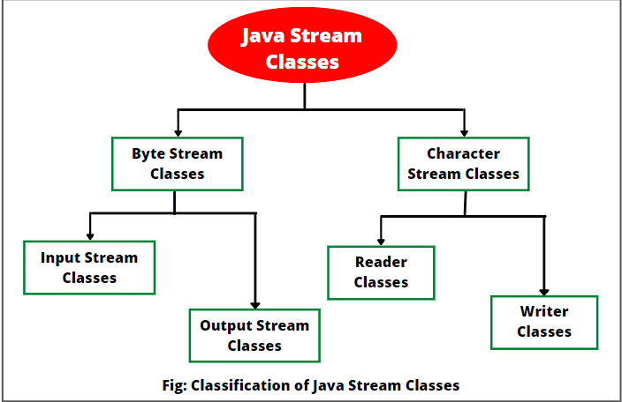

Slide 2
Reader Class
Reader in Java is an abstract class that reads characters from the files. In simple words, the reader class reads character streams.
It is the superclass of all reader subclasses. The concrete class that extends Reader class operates on Unicode character streams.
The Reader class of the java.io package is an abstract superclass that represents a stream of characters.
Subclasses of Reader
In order to use the functionality of Reader, we can use its subclasses. Some of them are:
BufferedReader
InputStreamReader
FileReader
StringReader

Slide 3
In order to create a Reader, we must import the java.io.Reader package first
// Creates a Reader
Reader input = new FileReader();
Methods of Reader
The Reader class provides different methods that are implemented by its subclasses. Here are some of the commonly used methods:
ready() - checks if the reader is ready to be read
read(char[] array) - reads the characters from the stream and stores in the specified array
read(char[] array, int start, int length) - reads the number of characters equal to length from the stream and stores in the specified array starting from the start
mark() - marks the position in the stream up to which data has been read
reset() - returns the control to the point in the stream where the mark is set
skip() - discards the specified number of characters from the stream

Slide 4
import java.io.Reader;
import java.io.FileReader;
class Main {
public static void main(String[] args) {
char[] array = new char[100];
try {
FileReader Reader input = new FileReader("input.txt");
// Checks if reader is ready
System.out.println("Is there data in the stream? " + input.ready());
input.read(array);
System.out.println("Data in the stream:");
System.out.println(array);
input.close();
}
catch(Exception e) {
e.getStackTrace();
} } }

Slide 5
Writer Class
The Writer class of the java.io package is an abstract superclass that represents a stream of characters.
Since Writer is an abstract class, it is not useful by itself. However, its subclasses can be used to write data.
Subclasses of Writer
In order to use the functionality of the Writer, we can use its subclasses. Some of them are:
BufferedWriter
OutputStreamWriter
FileWriter
StringWriter

Slide 6
In order to create a Writer, we must import the java.io.Writer package first.
// Creates a Writer
Writer output = new FileWriter();
Methods of Writer
The Writer class provides different methods that are implemented by its subclasses. Here are some of the methods:
write(char[] array) - writes the characters from the specified array to the output stream
write(String data) - writes the specified string to the writer
append(char c) - inserts the specified character to the current writer
flush() - forces to write all the data present in the writer to the corresponding destination
close() - closes the writer

Slide 7
import java.io.FileWriter;
import java.io.Writer;
public class Main {
public static void main(String args[]) {
String data = "This is the data in the output file";
try {
FileWriter Writer output = new FileWriter("output.txt");
output.write(data);
output.close();
}
catch (Exception e) {
e.getStackTrace();
} } }

Slide 8
FileReader Class
The FileReader class of the java.io package can be used to read data (in characters) from files.
It extends the InputSreamReader class.
Create a FileReader
In order to create a file reader, we must import the java.io.FileReader package first. Once we import the package, here is how we can create the file reader.
1. Using the name of the file
FileReader input = new FileReader(String name);
Here, we have created a file reader that will be linked to the file specified by the name.
2. Using an object of the file
FileReader input = new FileReader(File fileObj);
Here, we have created a file reader that will be linked to the file specified by the object of the file.

Slide 9
import java.io.FileReader;
class Main {
public static void main(String[] args) {
char[] array = new char[100];
try {
FileReader input = new FileReader("input.txt");
input.read(array);
System.out.println("Data in the file: ");
System.out.println(array);
input.close();
}
catch(Exception e) {
e.getStackTrace();
} } }

Slide 10
FileWriter Class
The FileWriter class of the java.io package can be used to write data (in characters) to files.
It extends the OutputStreamWriter class.
Create a FileWriter
In order to create a file writer, we must import the Java.io.FileWriter package first. Once we import the package, here is how we can create the file writer.
1. Using the name of the file
FileWriter output = new FileWriter(String name); Here, we have created a file writer that will be linked to the file specified by the name.
2. Using an object of the file
FileWriter input = new FileWriter(File fileObj);

Slide 11
import java.io.FileWriter;
public class Main {
public static void main(String args[]) {
String data = "This is the data in the output file";
try {
// Creates a FileWriter
FileWriter output = new FileWriter("output.txt");
// Writes the string to the file
output.write(data);
// Closes the writer
output.close();
}
catch (Exception e) {
e.getStackTrace();
} } }

Slide 12
BufferedReader
The BufferedReader class of the java.io package can be used with other readers to read data (in characters) more efficiently.
It extends the abstract class Reader.
Create a BufferedReader
In order to create a BufferedReader, we must import the java.io.BuferedReader package first. Once we import the package, here is how we can create the reader.
// Creates a FileReader
FileReader file = new FileReader(String file);
// Creates a BufferedReader
BufferedReader buffer = new BufferedReader(file);
// Creates a BufferdReader with specified size internal buffer BufferedReader buffer = new BufferedReader(file, int size);

Slide 13
import java.io.FileReader;
import java.io.BufferedReader;
class Main {
public static void main(String[] args) {
// Creates an array of character
char[] array = new char[100];
try {
// Creates a FileReader
FileReader file = new FileReader("input.txt");
// Creates a BufferedReader
BufferedReader input = new BufferedReader(file);
// Reads characters
input.read(array);
System.out.println("Data in the file: ");
System.out.println(array);
// Closes the reader
input.close();
}
catch(Exception e) {
e.getStackTrace(); } } }

Slide 14
BufferedWriter Class
The BufferedWriter class of the java.io package can be used with other writers to write data (in characters) more efficiently.
It extends the abstract class Writer.
Create a BufferedWriter
In order to create a BufferedWriter, we must import the java.io.BufferedWriter package first. Once we import the package here is how we can create the buffered writer.
// Creates a FileWriter
FileWriter file = new FileWriter(String name);
// Creates a BufferedWriter
BufferedWriter buffer = new BufferedWriter(file);
// Creates a BufferedWriter with specified size internal buffer BufferedWriter buffer = new BufferedWriter(file, int size);

Slide 15
import java.io.FileWriter;
import java.io.BufferedWriter;
public class Main {
public static void main(String args[]) {
String data = "This is the data in the output file";
try {
// Creates a FileWriter
FileWriter file = new FileWriter("output.txt");
// Creates a BufferedWriter
BufferedWriter output = new BufferedWriter(file);
// Writes the string to the file
output.write(data);
// Closes the writer
output.close();
}
catch (Exception e) {
e.getStackTrace();
} } }

Slide 16
StringReader
StringReader class is a character stream with string as a source. It takes an input string and changes it into character stream. It inherits Reader class.
In StringReader class, system resources like network sockets and files are not used, therefore closing the StringReader is not necessary.
The StringReader class of the java.io package can be used to read data (in characters) from strings.
It extends the abstract class Reader.
Create a StringReader
In order to create a StringReader, we must import the java.io.StringReader package first. Once we import the package here is how we can create the string reader.
// Creates a StringReader
StringReader input = new StringReader(String data);
Here, we have created a StringReader that reads characters from the specified string named data.

Slide 17
import java.io.*;
public class DataStreamExample {
public static void main(String[] args) throws Exception {
String srg = "Hello Java!! \nWelcome to Javatpoint.";
StringReader reader = new StringReader(srg);
int k=0;
while((k=reader.read())!=-1){
System.out.print((char)k);
}
}
}

Slide 18
StringWriter
Java StringWriter class is a character stream that collects output from string buffer, which can be used to construct a string. The StringWriter class inherits the Writer class.
In StringWriter class, system resources like network sockets and files are not used, therefore closing the StringWriter is not necessary.
The StringWriter class of the java.io package can be used to write data (in characters) to the string buffer.
It extends the abstract class Writer.
Create a StringWriter
In order to create a StringWriter, we must import the java.io.StringWriter package first. Once we import the package here is how we can create the string writer.
// Creates a StringWriter
StringWriter output = new StringWriter();
// Creates a StringWriter with specified string buffer capacity StringWriter output = new StringWriter(int size);

Slide 19
import java.io.StringWriter;
public class Main {
public static void main(String[] args) {
String data = "This is the text in the string.";
try {
// Create a StringWriter with default string buffer capacity
StringWriter output = new StringWriter();
// Writes data to the string buffer
output.write(data);
// Prints the string writer
System.out.println("Data in the StringWriter: " + output);
output.close();
}
catch(Exception e) {
e.getStackTrace();
} } }

Slide 20
Access Data from StringBuffer
getBuffer() - returns the data present in the string buffer
toString() - returns the data present in the string buffer as a string
public class Main {
public static void main(String[] args) {
String data = "This is the original data";
try {
StringWriter output = new StringWriter();
// Writes data to the string buffer
output.write(data);
// Returns the string buffer
StringBuffer stringBuffer = output.getBuffer();
System.out.println("StringBuffer: " + stringBuffer);
// Returns the string buffer in string form
String string = output.toString();
System.out.println("String: " + string);
output.close();
}
catch(Exception e) {
e.getStackTrace();
} }}

